Slide 1
Job Aggregator
Hemachandar Nagarajan
Pawan Punera
Pinkesh Nayak
Sahibzada Aasim Imtiyaz

Slide 2
Objective
Our objective is to create a dataset consisting of job listings from various Job Boards and Aggregators and Staffing firms.
What is a Job Aggregator: Pull job postings from a variety of career sites and job boards so they can all be viewed in one location.

Slide 3
How this data was created
They are compiled by scanning the internet daily using bots that seek out job postings on job boards, corporate websites, and other places where job ads are posted.

Slide 4
Data Acquisition

Slide 5
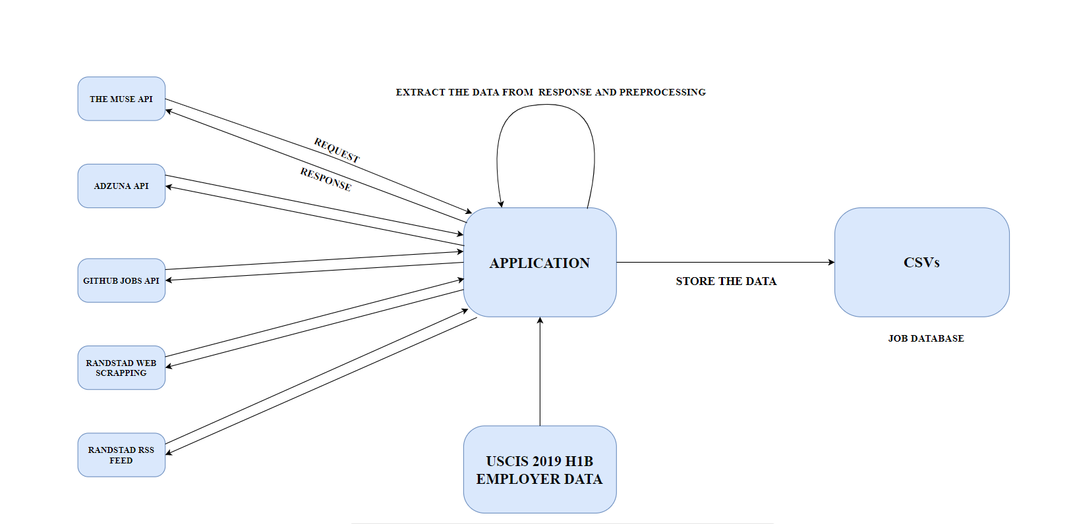

Slide 6
List of APIs used
GitHub Jobs
Adzuna
The Muse

Slide 7
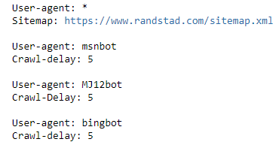
Web Scrapping
We scrapped https://www.randstad.com/ , which is a staffing firm site.
We checked with the website’s robot.txt and It allowed crawling with 5 sec delay

Slide 8
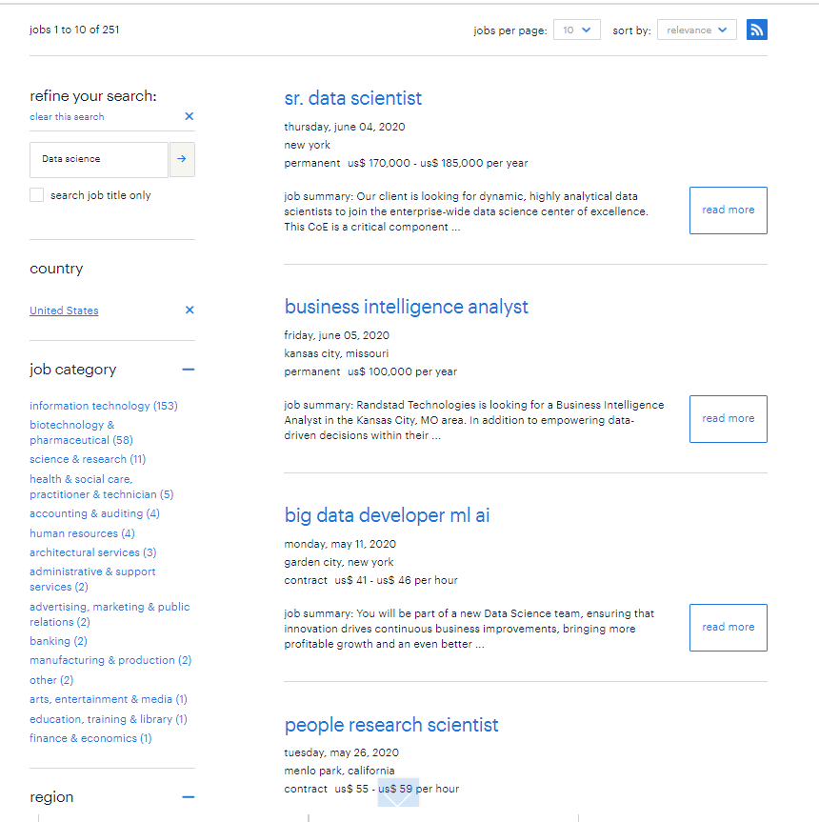
https://www.randstad.com/jobs/united-states/q-data-science/

Slide 9
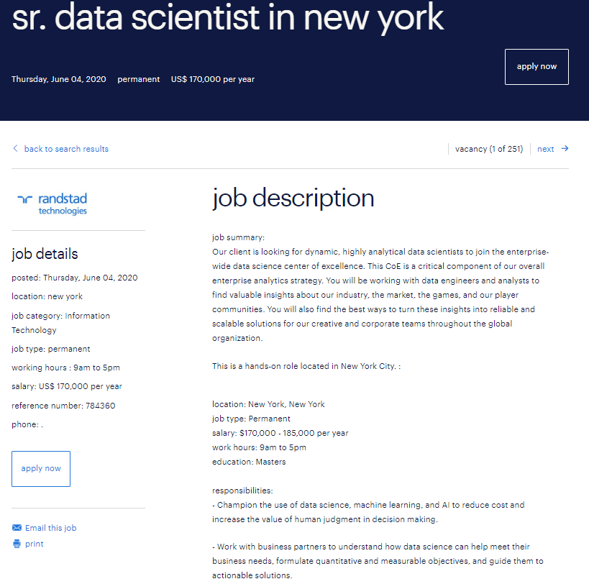
https://www.randstad.com/jobs/united-states/q-data-science/

Slide 10
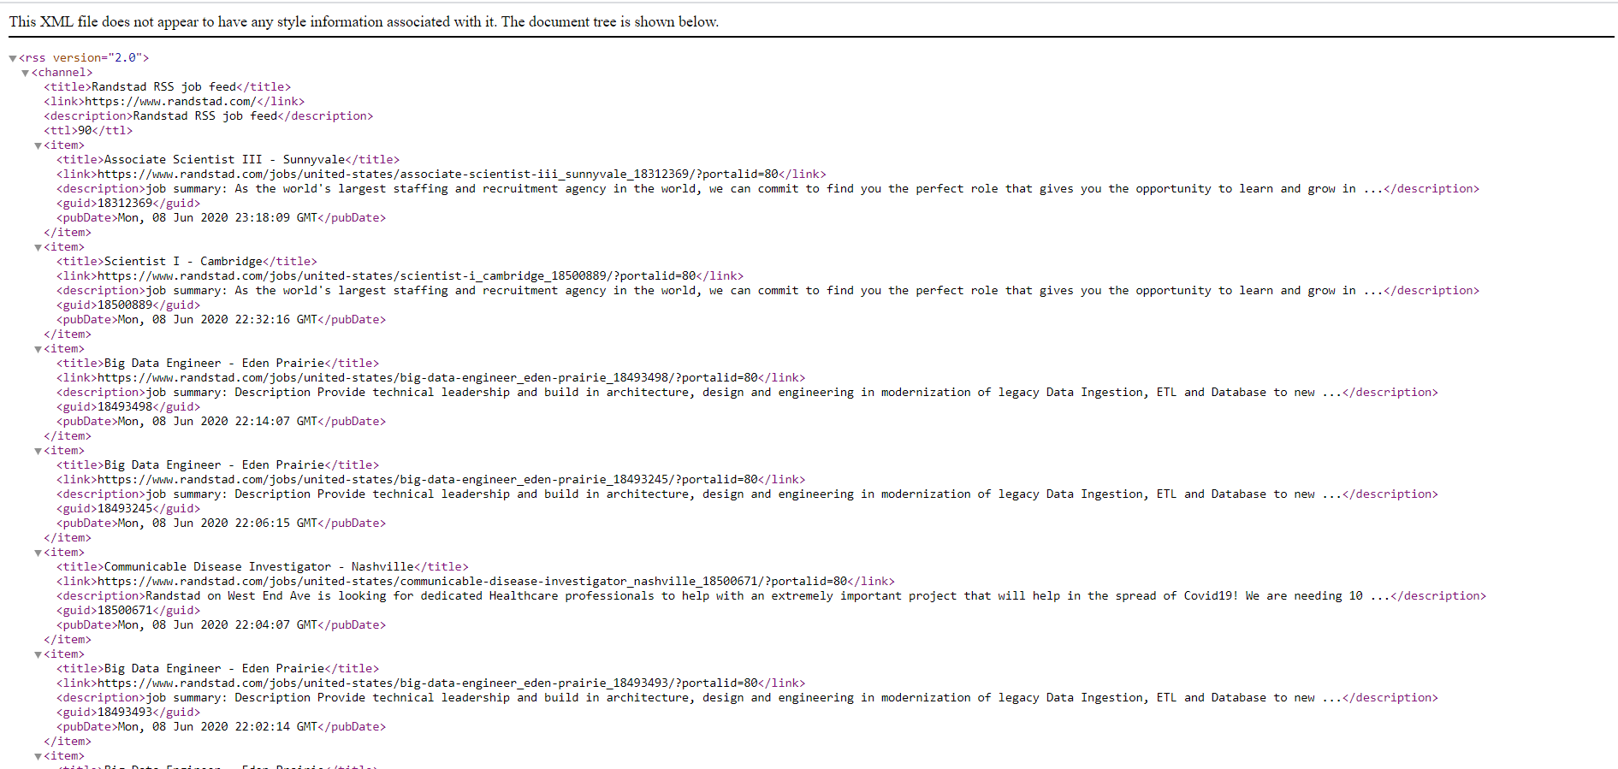
RSS feed
https://www.randstad.com/jobs/rss/united-states/q-data-science/

Slide 11

Every hour we fetch the new/updated data from the RSS feed

Slide 12
Most of the international applicants find it difficult to check for every job posting whether the company offers H1B sponsorship or not.
We collected last years H1B statistics from USCIS site which was openly available .
We merged this with our dataset to find which all companies offer sponsorship and how many applications were filed which were approved and rejected. (this is an important thing for international applicants)

Slide 13
United States Citizenship and Immigration Services
The H-1B Employer Data Hub allows you to download data for individual fiscal years.
API here is in CSV format.
The CSV files give you the ability to conduct your own analyses of these data, including calculating approval and denial rates by employer.

Slide 14
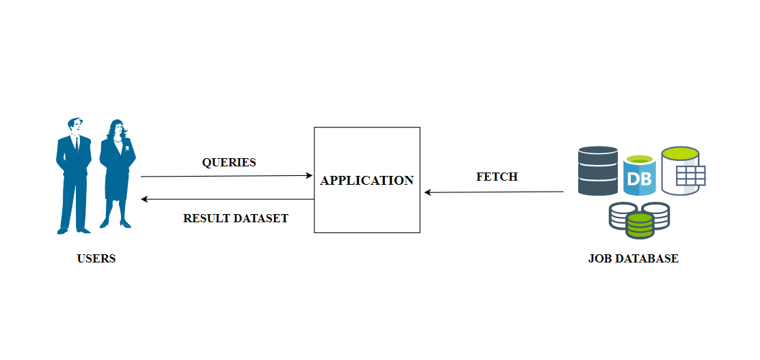

Slide 16
Who might be interested in this data
International Applicants
Graduates/Jobseekers
Educational institutions
Government agencies
Consultancies/ Industries
Data Scientists who want to perform further analysis

Slide 17
Terms of Use
While fetching data we were diligent about the terms and followed all the terms of use.

Slide 18
Limitations
The quality of the data can be improved by web scrapping from multiple sources of websites. But most of the sites don’t allow scrapping. We need to get permission.
Many APIs have rate limit which limits the data we can access from that site.
We are considering only few sources for job posting. We may not get all the data related to that posting.

Slide 19
Thank You

